Slide 1
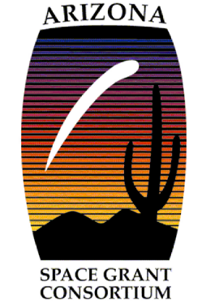
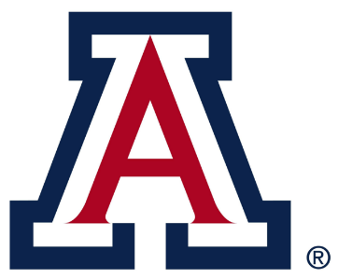
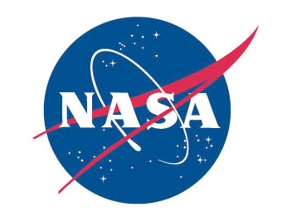
Formation of graphitic carbon on metallic substrates: Implications for protoplanetary nebular carbon delivery, and meteoritic sample analysis
Chris Tang
Materials Science and Engineering
Arizona Space Grant Symposium
Arizona State University
Tempe, Arizona
April 22, 2017
Mentor: Krishna Muralidharan

Slide 2
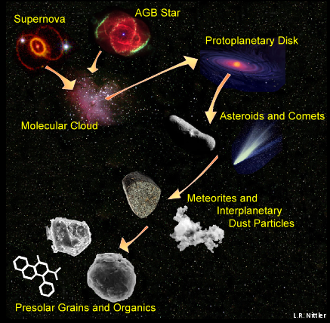
Introduction
Circumstellar environments (CSE) are rich in hydrocarbon compounds.
Chemical interactions between metal condensates and hydrocarbons can reveal possible methods of carbon transport from the CSE to protoplanetary disk.

Slide 3
Question
Can graphitic carbon be synthesized on metal condensates within the circumstellar environment?
Implications
New insights into chemical pathways that underlie carbon migration into the disk

Slide 4
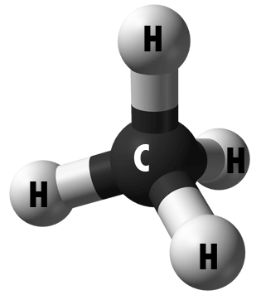
CSE at the Lab Scale
Mimic the circumstellar environment using a LPCVD (low pressure chemical vapor deposition) reactor.
Low pressure and high temperature correspond to the local environment of a circumstellar disk.

Slide 5
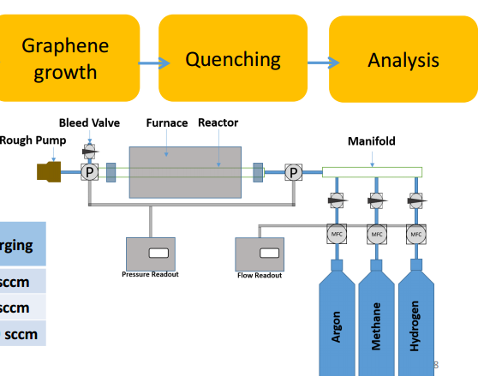
Schematic of the CVD reactor
Graphite

Slide 6
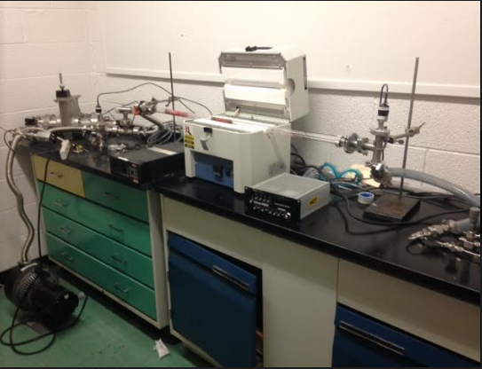
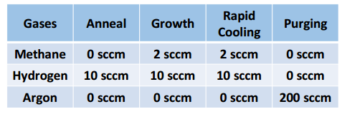
Construction of the CVD Reactor
Gas flow
Temperature: 1050 ºC
Pressure: ~10⁻³ Torr
Time: 60 min
CVD reactor that was constructed to create graphite sample

Slide 7
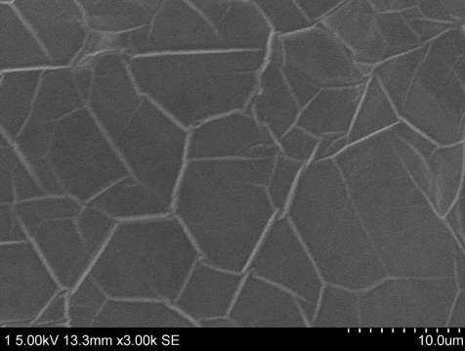
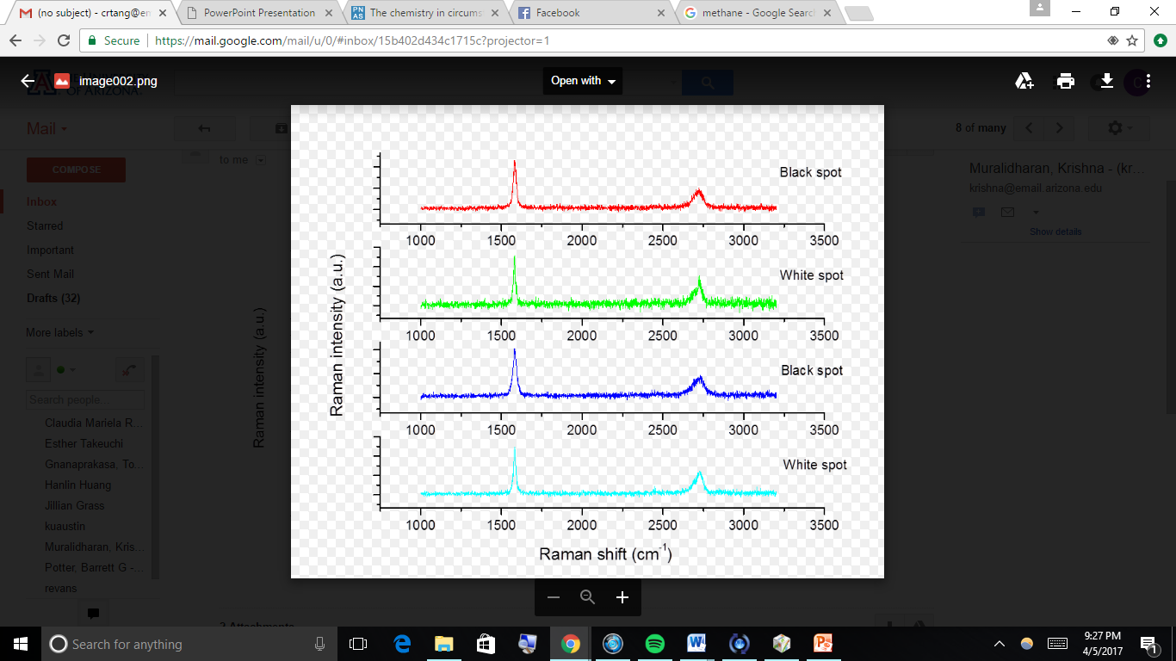
(The most important) Result
Results
SEM image of graphitic carbon deposited onto nickel
Raman spectrum consistent with multilayer graphene/graphite

Slide 8
Conclusions
At high temperatures, catalytic decomposition of CH₄ on Ni was obtained, leading to formation of graphitic carbon on the substrate.
Metal condensates can serve as important carbon carriers into the disk
Similar mechanisms should underlie the formation of carbon nanotubes/fullerenes
Subsequent processing of graphite can lead to formation of prebiotic precursors (alcohol, amine, sugar)-(future work)
Possible circumstellar envelope origin of metal nuggets found within graphitic matrices in meteorites

Slide 9
Acknowledgements
Krishna Muralidharan
Tony Gnanaprakasa
Warren Beck

Slide 10
Thank you

